Slide 1

Special Report:
Flood Outreach in Kentucky
Kayla Watts
Agent on Special Assignment
Community Recovery & Resiliency

Slide 2

Why the Special Report?
Patterns of weather-related disasters
  Tornados
  Flooding
  Ice/Winter Storms
County Extension Agents always respond
How do we “capture” the Extension impact?
Notes:
Explain the importance of this report.
Reasons for the report: patterns/re-occurrence of weather-related disasters throughout Kentucky
Eastern Kentucky floods
Western Kentucky tornados
Extension Agents always respond to help their communities.
Sometimes this help is done by local offices or in partnership with Extension related volunteer organizations; Cattleman’s, Homemakers, 4-H Councils.
How do we capture all this wonderful work Extension has completed?
This is how the report came into existence.

Slide 3

Data & Collection Methods
Agent Records
Outside Organization Records
  Volunteer Organizations
  Government Organizations
Data Collection
  Compile records from all partner groups
  Enter data into Qualtrics
Notes:
What is the data that is presented on this report and how was it collected?
County Report:
Data – Various data points related to specific county and initiatives within those counties.
Area Report:
Data – Various data points – a collection of the five-county area (Breathitt, Knott, Leslie, Letcher, Perry). Leslie County data was included in this report because they housed a distribution site for Extension.
Outside organizational leaders shared data collected about programs/initiatives where Extension was a direct partner on specific efforts. Example: Kentucky Cattleman’s Association, Kentucky Extension Homemakers Association, and Others
Data Collection:
Weeks of collecting data records – Volunteer sign-in, Hours worked by volunteers, Tracking of items/equipment, Tracking of donated dollars
Compilation of Data by County – Entered final data into Qualtrics Program to generate county and area-wide reports

Slide 4
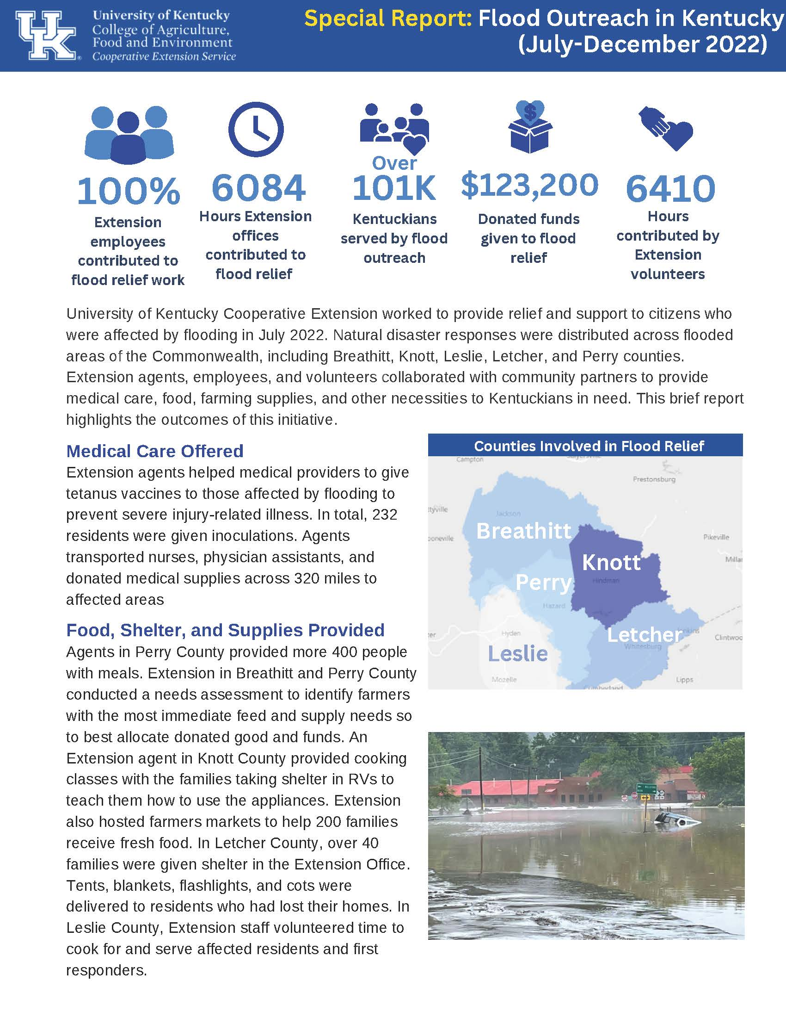
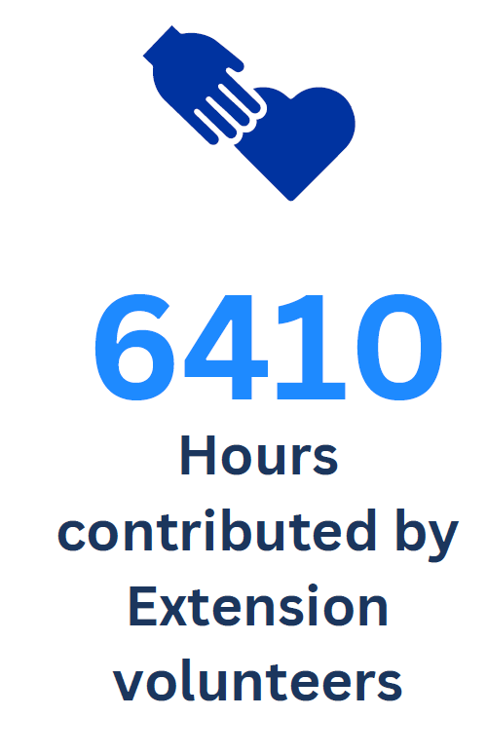
Report Breakdown
Impact Numbers
  Across the top of the report
  Highlights major initiatives
  Different for each county report
  The Area Report is reflective of five counties; Breathitt, Knott, Leslie, Letcher, and Perry.
Notes:
Report Breakdown – Impact Numbers
Begins with highlighting impact numbers across the top
Explain that these are different for each individual county report and that the area report reflects numbers from the 5-county area
*Read through and make comments on these impact numbers with the audience

Slide 5
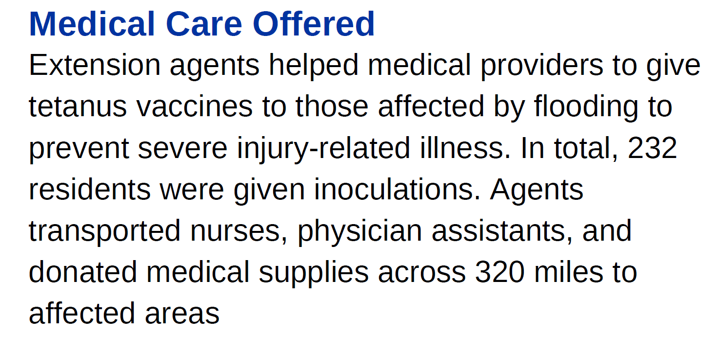
Report Breakdown
Written Narrative
  Agent submitted success stories
  Detailed information related to impact numbers from top of report
Notes:
Report Breakdown – Written Narrative
Submitted by Extension Agents and further explains outreach efforts
*Read over highlighted Success Story Titles on the report

Slide 6
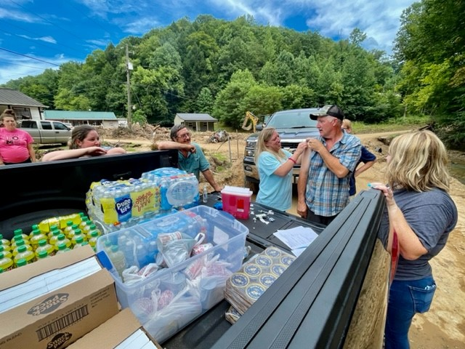
Report Breakdown
Map & Photos
  Showcases county/area of Kentucky reflected in report
  Pictures taken by UK Cooperative Extension Agents
Notes:
Report Breakdown – Maps & Photos
Talk about map – maybe even specifically talk about certain areas within your county where work was most impactful
Talk about photos – Agents, Volunteers, Groups in the photos
Talk about what is being done in the photos or programs that were taking place in the photos

Slide 7
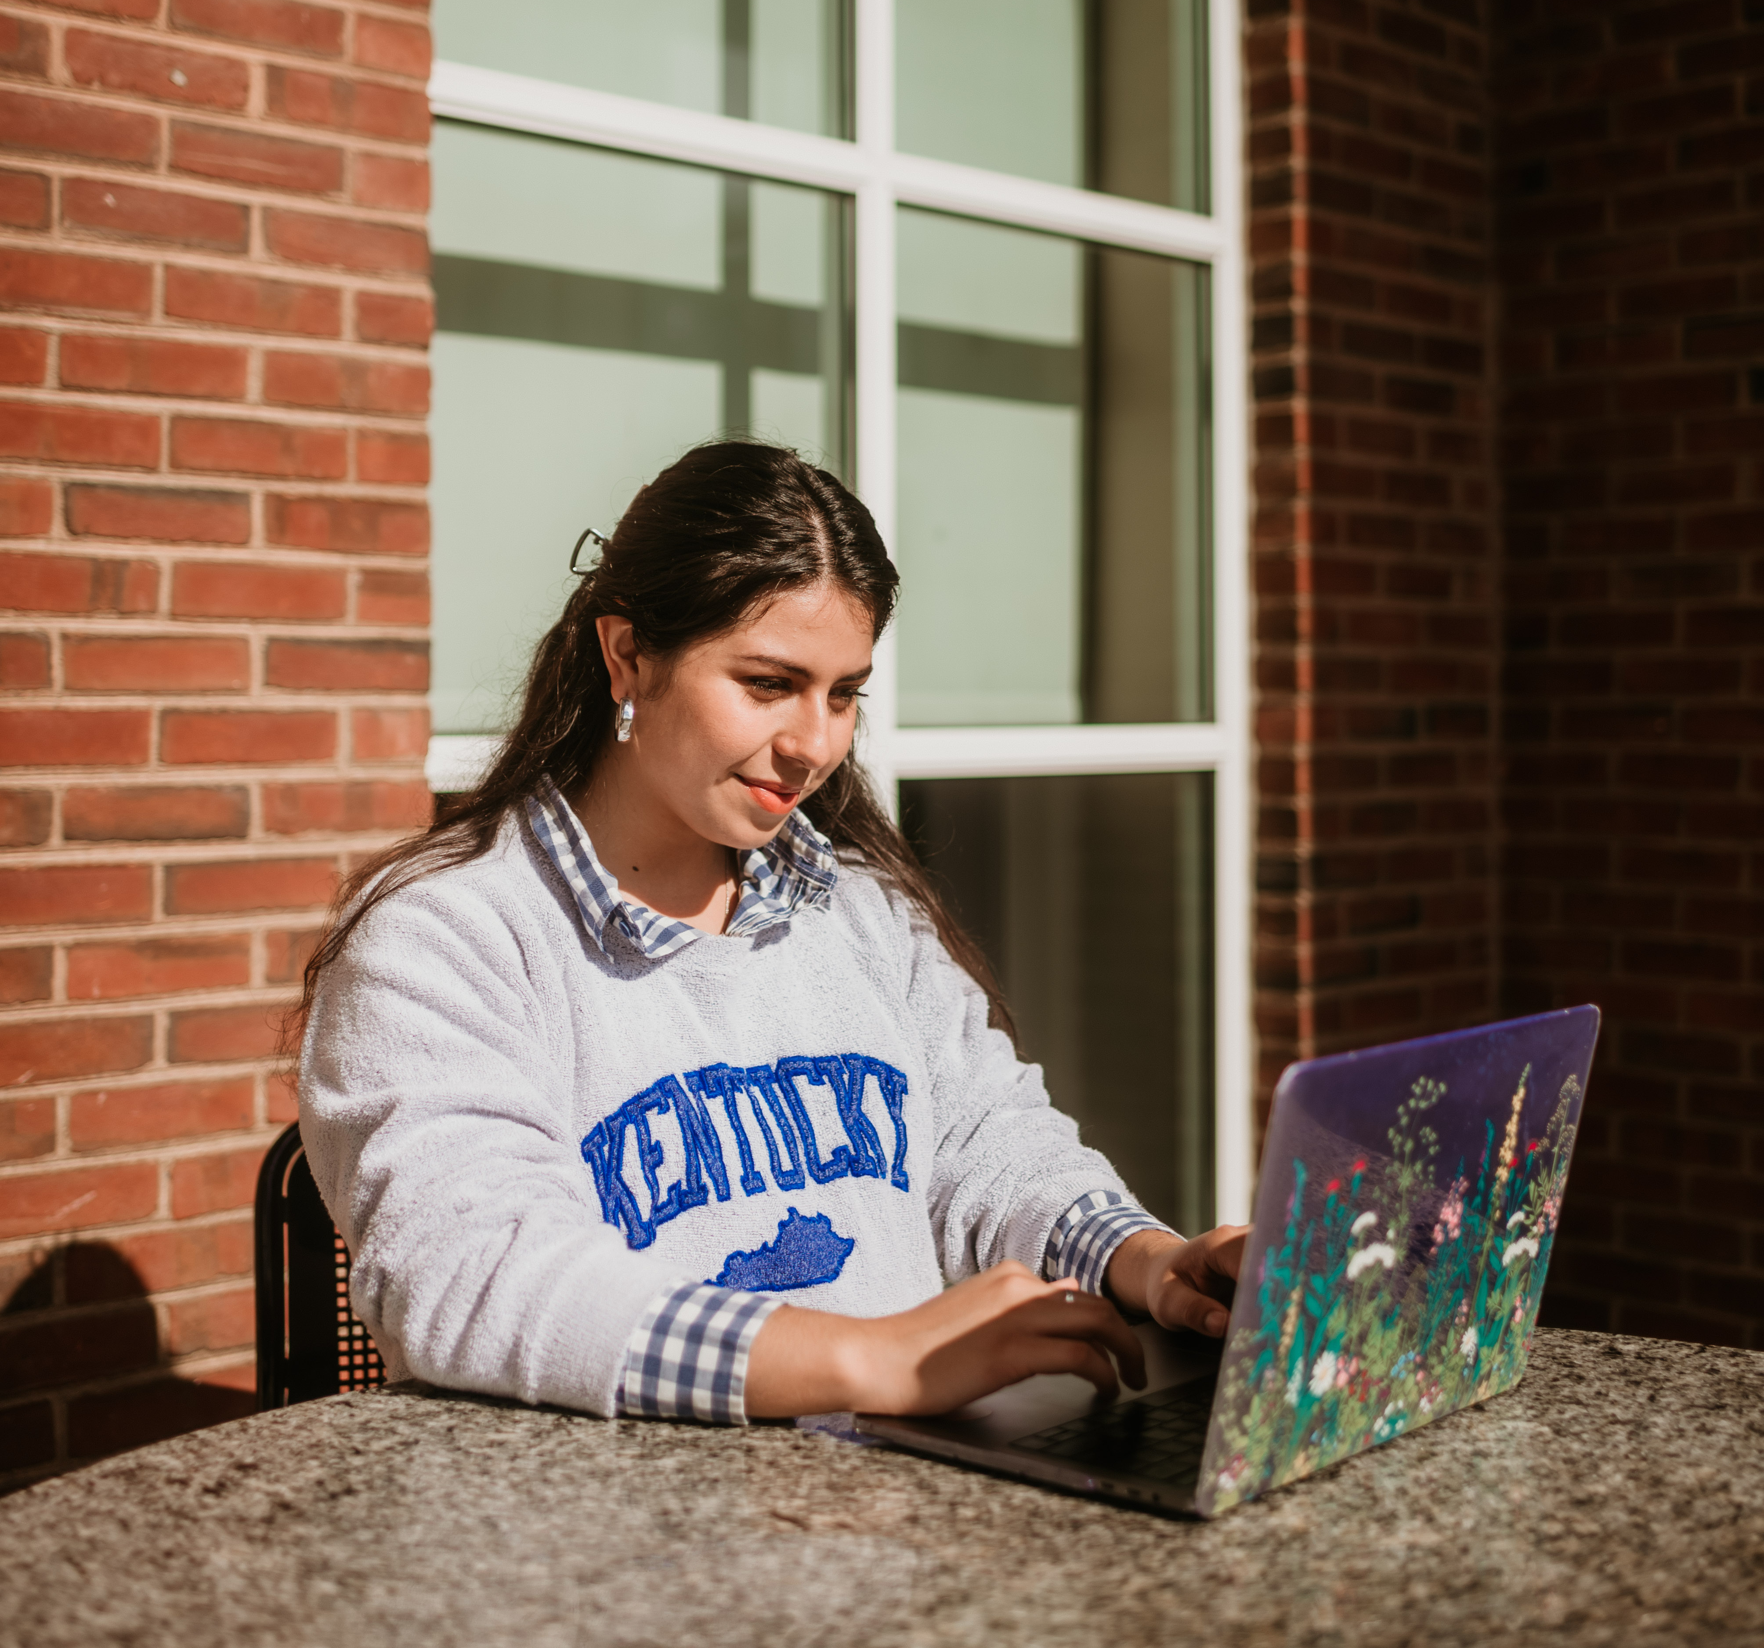
Conclusion
We will continue to track Cooperative Extension Agent’s work in the flood recovery process.
Questions/Comments about the report?

Slide 8


