Slide 1

Crisis Communications
UK Public Relations & Strategic Communications
Cameron Sellers
Kentucky State University
Community Resource Development
Disaster Educator

Slide 2
Objectives
Answer: What is the UK Crisis Communications Team
Signing up for UK alert notifications through your phone
Responding to Media during disasters

Slide 3
UK Crisis Communications Team
Public Relations Team
Oversees the university’s crisis communications plan
Help leads the institution’s communications response during a crisis
For all audiences and stakeholders (including campus, media, the public)
Works closely with:
UK Police
UK leadership
Legal
Risk Management
Colleges and other officials

Slide 4
What is considered a crisis?
Event, incident or issue that causes major disruption and threatens an organization’s ability to operate.
It threatens the safety of our community or causes severe reputational damage.
Important issues or events which call into question our values, integrity, compliance, legal risk or care for those we serve.
These can turn into serious issues if not properly managed
Examples:
Natural disasters
Active aggressor
Pandemic
Other hazards
Allegations of systematic or deliberate serious wrongdoing
Other legal, political, financial or reputational events

Slide 5
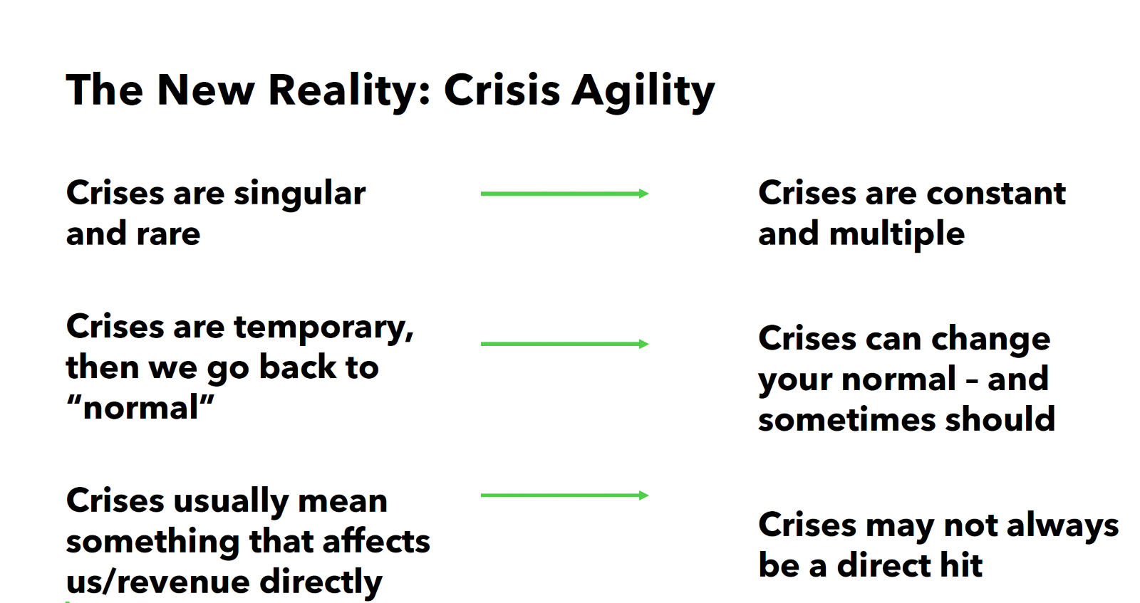
Communication phases of a crisis
Respond with compassion and action
Immediate
Recover with transparency
Intermediate
Restore with authenticity
Long term
Have a plan – update it and practice it ​

Slide 6
Begin Activity

Slide 7
What to do if you receive a media request during a crisis
DO NOT RESPOND

Slide 8
(Actually) Begin Activity

Slide 9
What to do if you receive a media request during a crisis
Direct the reporter to contact UK Public Relations.
Don’t offer any additional comment.
Let UK Public Relations know about the request.
Contact ukpr@uky.edu or on-call phone number 859-230-9086
The university spokesperson (or designee) is the only person authorized to speak to the media during a crisis.

Slide 10
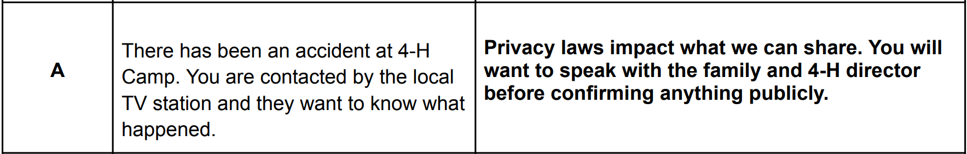
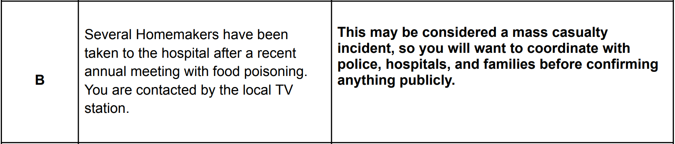
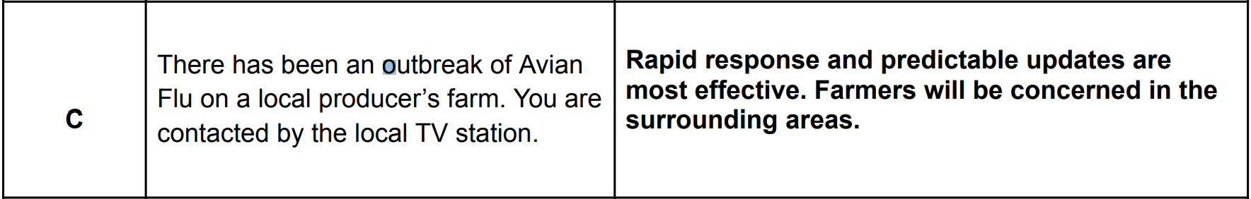



Slide 11
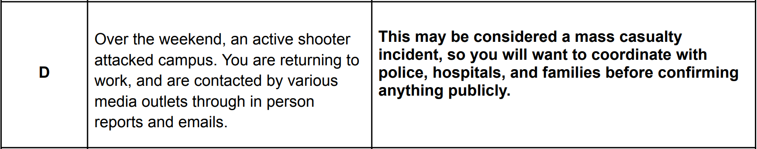
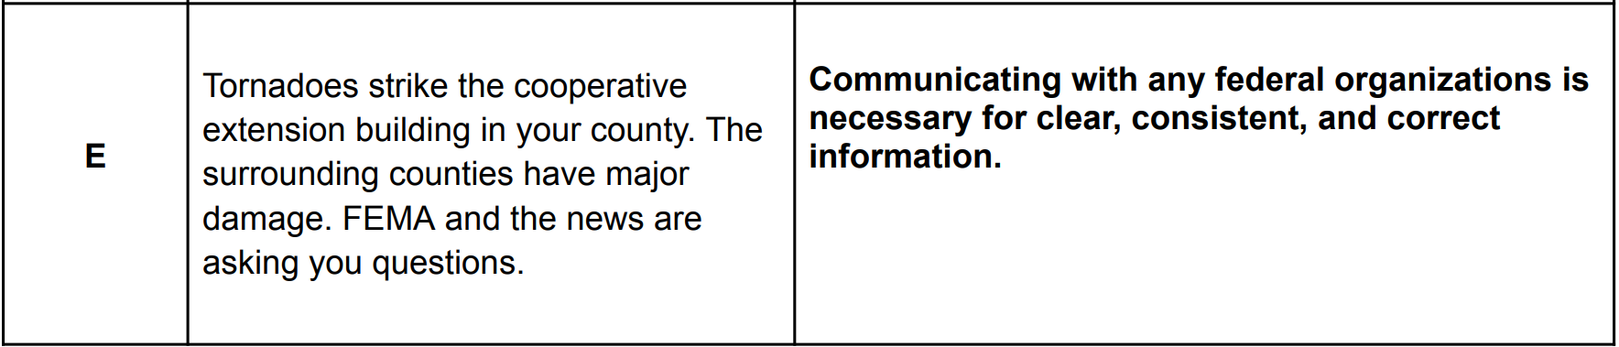

Slide 12

Best practices followed by UK Crisis Comms Team
Clear, consistent and transparent communication
Rapid response – moments, not hours
Predictable updates and resources (website, number to call, daily update) helps create order in times of chaos
Frequent, scheduled public updates and internal briefings
Community - first communications
We prioritize communicating to our campus community first. We want them to receive important information from us first rather than the news.
This helps maintain trust and establishes the institution as the source for information.
Procedures/ Sensitivity for death and injury notifications
Speaking with a family first; then the individual’s affiliated college, office or other group affiliations before ever confirming anything publicly.
Privacy laws also often impact what we will share
If a mass casualty incident: in coordination with police, hospital, family before confirming publicly

Slide 13
Best practices followed by UK Crisis Comms Team
Clear, consistent and transparent communication
Rapid response – moments, not hours
Predictable updates and resources (website, number to call, daily update) helps create order in times of chaos
Frequent, scheduled public updates and internal briefings
Community - first communications
We prioritize communicating to our campus community first. We want them to receive important information from us first rather than the news.
This helps maintain trust and establishes the institution as the source for information.
Procedures/ Sensitivity for death and injury notifications
Speaking with a family first; then the individual’s affiliated college, office or other group affiliations before ever confirming anything publicly.
Privacy laws also often impact what we will share
If a mass casualty incident: in coordination with police, hospital, family before confirming publicly

Slide 14
Best practices followed by UK Crisis Comms Team
Clear, consistent and transparent communication
Rapid response – moments, not hours
Predictable updates and resources (website, number to call, daily update) helps create order in times of chaos
Frequent, scheduled public updates and internal briefings
Community - first communications
We prioritize communicating to our campus community first. We want them to receive important information from us first rather than the news.
This helps maintain trust and establishes the institution as the source for information.
Procedures/ Sensitivity for death and injury notifications
Privacy laws also often impact what we will share
If a mass casualty incident: in coordination with police, hospital, family before confirming publicly
Speaking with a family first; then the individual’s affiliated college, office or other group affiliations before ever confirming anything publicly.

Slide 15
What to expect during a crisis
At UK | In a local Community
UK Alert – Official emergency notifications All UKY emails automatically registered. Alert system also includes UK social media, the uky.edu website and more. You may receive additional emails from UK leadership. If the crisis impacts your extension office, you can expect a College representative or a member of the Crisis Communications Team to be reaching out. | City Government: The city government, public safety offices or emergency management agency should be communicating through their official channels. This could include emergency notification texts, calls or emails; social media; local media and more. Check your local media but remember that official information should come directly from the organization/municipality and public safety officials.

Slide 16
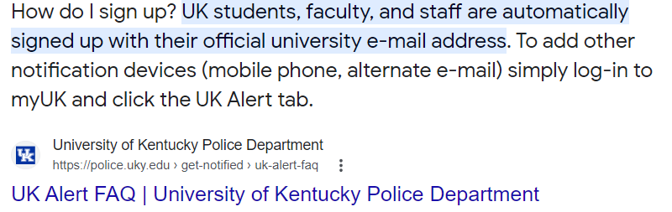
How do I sign up?

Slide 17
How to prepare I
Sign-up for emergency notifications
UK Alert (UK employee, student, parent or other stakeholder)
Local emergency notifications in your county or city
Consider other planned communications or events
Do any of these need to be paused or rescheduled?
Social media posts
Email newsletters
Events
Remember though, overreaction can sometimes amplify an issue that is not yet a crisis

Slide 18
Plan and have a process in place
If you become aware of a serious issue at UK:
Contact police in an emergency
Marketing and Strategic Communications Director-Derrick Meads djmead3@email.uky.edu
UK Crisis Communications Team: ukpr@uky.edu
Internal & external contact lists:
Have your contact lists ready and easily accessible
Working with the college or UKPR
Provide information on important stakeholders who may need to receive communication

Slide 19
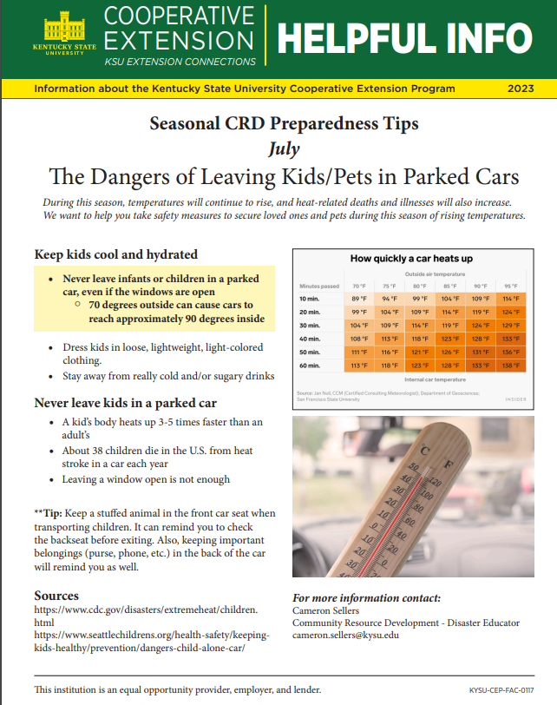
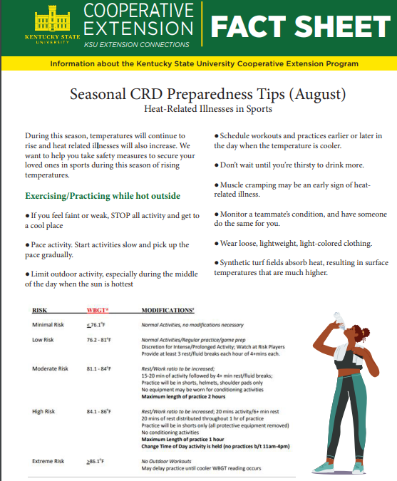


Slide 20
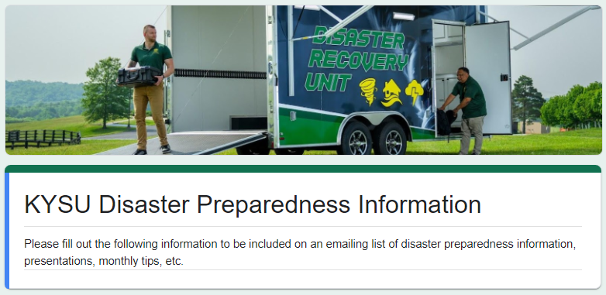
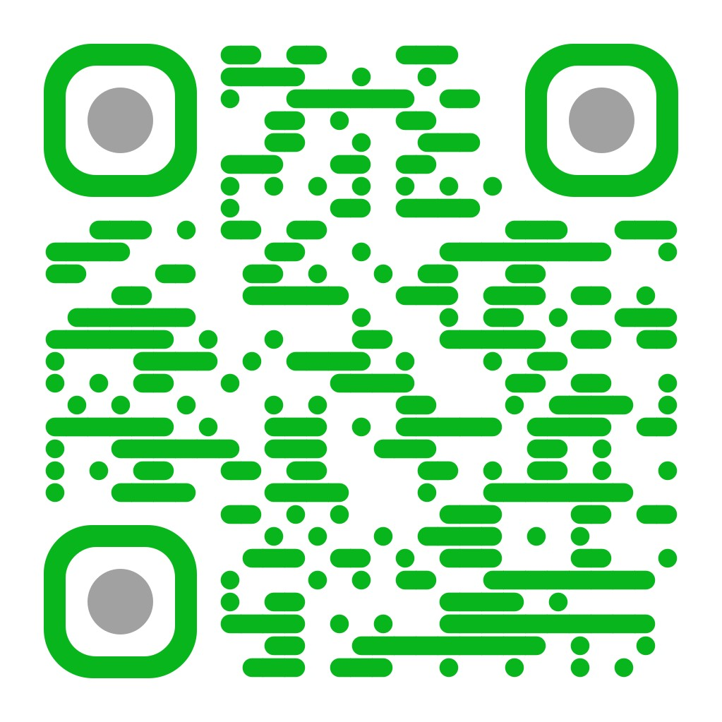
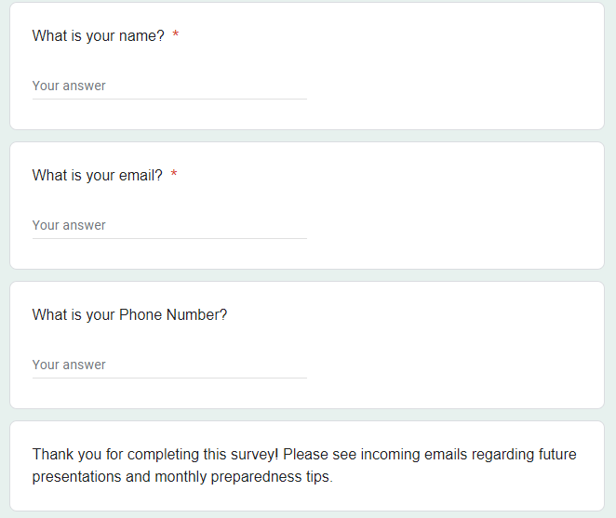

Slide 21


Questions

Slide 22


